Slide 1

Exploring Wildlife Trafficking Data
Team Members:
VAMSHI NAIK VISLAVATH (vv2289)
ADITYA GOUROJU (ag9979)
ARYAN PRASAD (ap7949)
Notes:
Good afternoon everyone my name is Aditya, Today I will be presenting on Analysis of Wildlife Trafficking Data along with my teammates Aryan and Vamshi.
The insights gained from this analysis aim to contribute to evidence-based strategies for combating trafficking, promoting biodiversity conservation, and addressing this global crisis pushing numerous species towards extinction.

Slide 2
Dataset
We get our data from the ETL pipeline already implemented by the VIDA centre at NYU.
There are a few major improvements to this data done recently that brings the accuracy of the data to around 81%.
The novel design of this new pipeline is to utilize the Bert based Model to investigate on the ‘title’ of the ad and draw conclusion as to whether the ad is related to animal or not.
We examine the outputs of two models - GPT 3.5 and the BERT-based model - by feeding them the same input (the title of an advertisement) and comparing the resulting labels.
Notes:
We got this dataset from an ETL pipeline which is established by the VIDA center at NYU. This data has 81% accuracy. It uses Bert based Model to investigate on the ‘title’ of the ad and draw conclusion as to whether the ad is related to animal or not. Here a thorough comparison of outputs from both GPT and BERT based model is done by feeding same inputs.

Slide 3
Problem Statement:
Our data, sourced through ETL pipelines via web crawling, contains crucial details including image links, seller names, species descriptions, products, and prices. We aim to analyze:
1.Seller similarity: Identifying instances where one seller is similar to other seller.
2.Illegal and Endangered Species: Assessing whether traded species are classified as illegal or endangered.
3.Geographic Locations: Analyzing the geographic distribution of data.
4.Most Frequently Traded Species: Determining which species are traded most often.
5.Price Range of Species: Examining the price ranges of species sold online.
6.Duplicate Advertisements: Detecting duplicate ads within the same marketplace.
7.Largest Sellers: Identifying the most prominent sellers in terms of transaction volume.
8.Seller Collaboration: Exploring whether certain sellers exhibit collaborative behaviors.
Notes:
As part of our project we try to analyze the data to answer some questions that can be used to draw valuable insights.
Let's start with our exploration of seller similarity. In our analysis, we delve into instances where one seller resembles another in various aspects such as product listings, pricing strategies, or geographic reach. Understanding seller similarity is crucial for grasping market dynamics and competition within the online wildlife trade.
Moving on to our examination of illegal and endangered species in online trade. We devised solutions to evaluate this which we will see in upcoming slides, we evaluate whether the species being traded fall under categories of illegality or endangerment.
By analyzing the geographic origins and destinations of traded species, we gain valuable insights into the spatial dynamics of the trade network.
There are few more crucial problems which we try to address like price range distribution, biggest sellers, duplicate/similar advertisements.

Slide 4
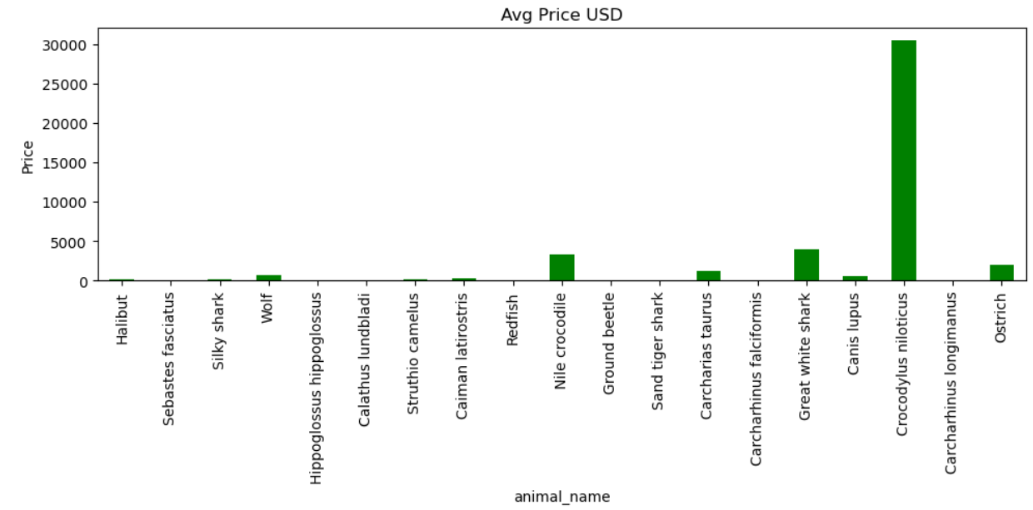
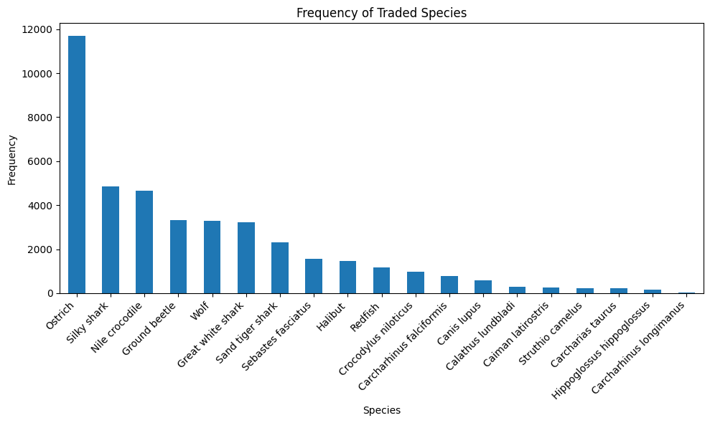
Frequency and Price range of animals:
Notes:
Species with high average costs but infrequent trade are often endangered. Their scarcity and high value can incentivize illegal hunting. This underscores the need for strong conservation strategies and strict enforcement of wildlife trade regulations to protect these vulnerable species. From our analysis Nile crocodile and Great white shark come under this category

Slide 5
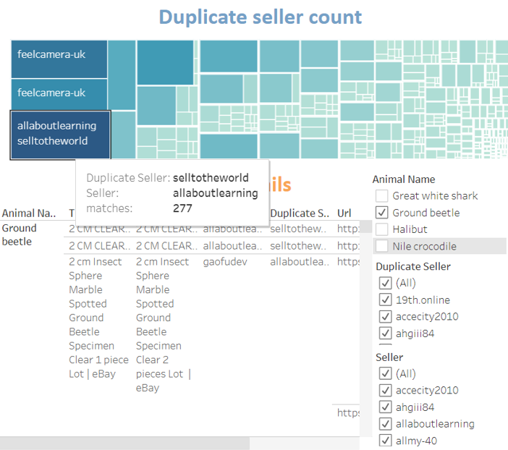
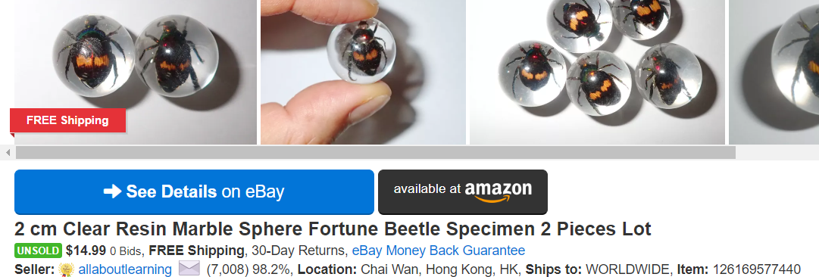
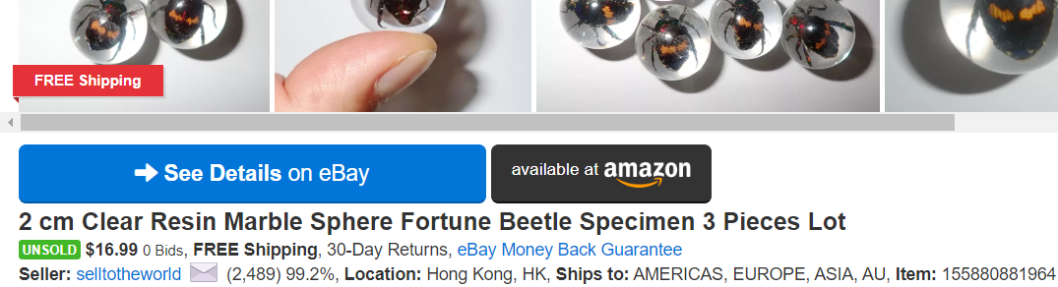
Seller Similarity:
Our methodology follows a structured path to identify similarities among sellers, focusing on their product offerings. We start by organizing data based on the type of animal being sold. Next, we employ a powerful fuzzy matching technique, setting a stringent 95% similarity threshold, to compare sellers' listings. Aggregated results are then visualized in a dynamic Tableau dashboard, highlighting sellers with the most similar listings.
Notes:
First image link : https://picclick.com/2-cm-Clear-Resin-Marble-Sphere-Fortune-Beetle-155880881964.html
Second : https://picclick.com/2-cm-Clear-Resin-Marble-Sphere-Fortune-Beetle-126169577440.html

Slide 6
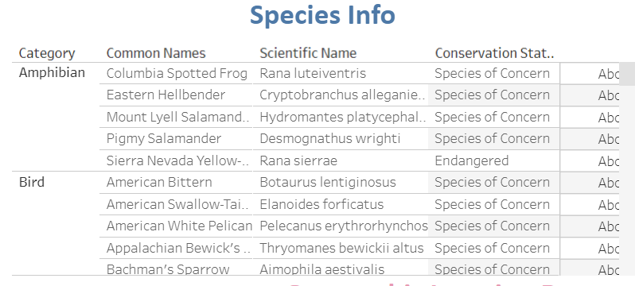
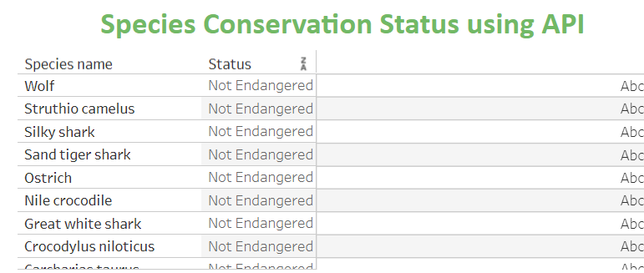
Illegal and Endangered Species:
In our analysis, we begin by filtering unique species names from the data. We then cross-reference these names with the IUCN Red List data to check for conservation status information. If no data is found, we utilize the ChatGPT API to determine the conservation status of the species, particularly if they are endangered. The Tableau dashboard provides detailed insights into the conservation status of animals in our dataset.

Slide 7
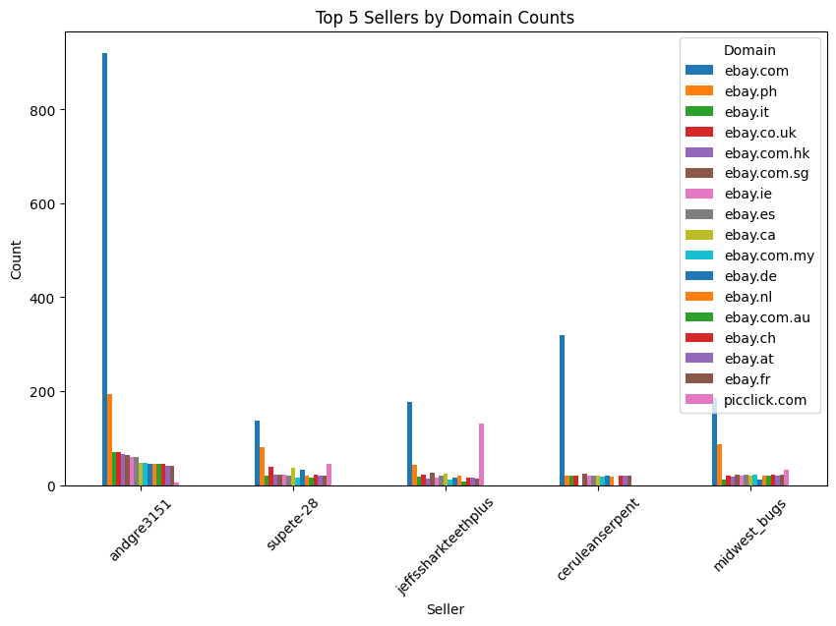
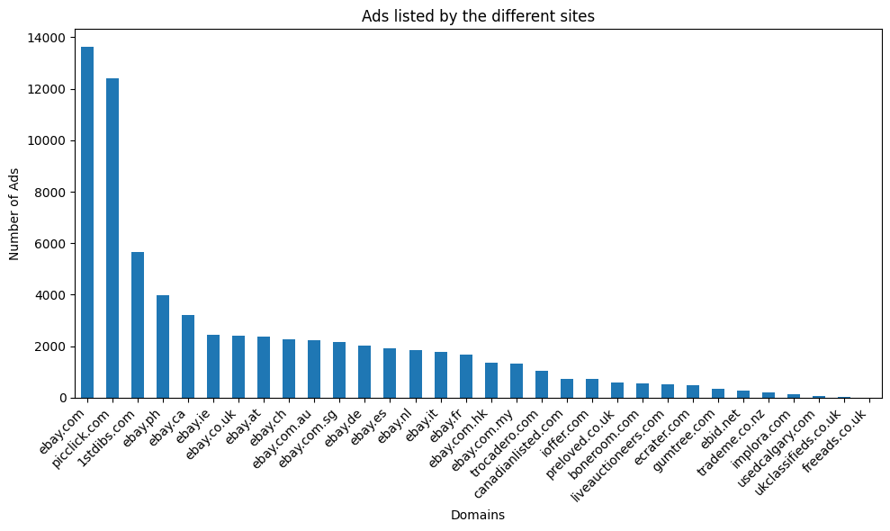
Domain Distribution by Top Sellers
How ?
Why ? - Importance - Insights
Notes:
HOW - In our data analysis, we examine the distribution of sellers based on the domains where they list their ads.
IMPORTANCE - This analysis serves a dual purpose. Firstly, it helps us understand why certain domains are predominantly used for animal listings. By delving into the policies of these domains, we can assess if they favor animal products. Additionally, it allows us to determine if our data collection process, particularly our web crawler, exhibits bias towards extracting ads from specific sites.
INSIGHTS - Our findings reveal that eBay stands out as the platform with the largest number of ads, indicating its significance in the market. This insight prompts us to further investigate eBay's policies regarding animal product listings. Moreover, it emphasizes the importance of continuously monitoring our data collection methods to ensure unbiased results.

Slide 8
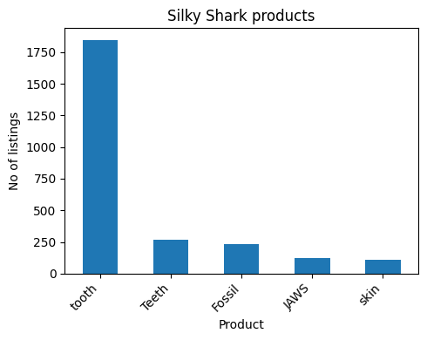
Product distribution by animal
How ?
Why ? - Importance - Insights
Notes:
HOW - Our data has pre labeled animal label and its species, additionally we have its Product type. We use these two features to get the distribution.
IMPORTANCE - Majorly this will give us the Consumer preference and market demand for various products. So for eg. in the graph we can see that silky shark’s Tooth is the most sold item and this indicates a market demand for the above product type. Had the product type been skin or fur it would indicate a demand for it in the fashion industry.
This graph is a small portion of the consolidated distribution of all the animals providing a better insight of one of the animals and here we can see that tooth dominates the market for silky shark.

Slide 9
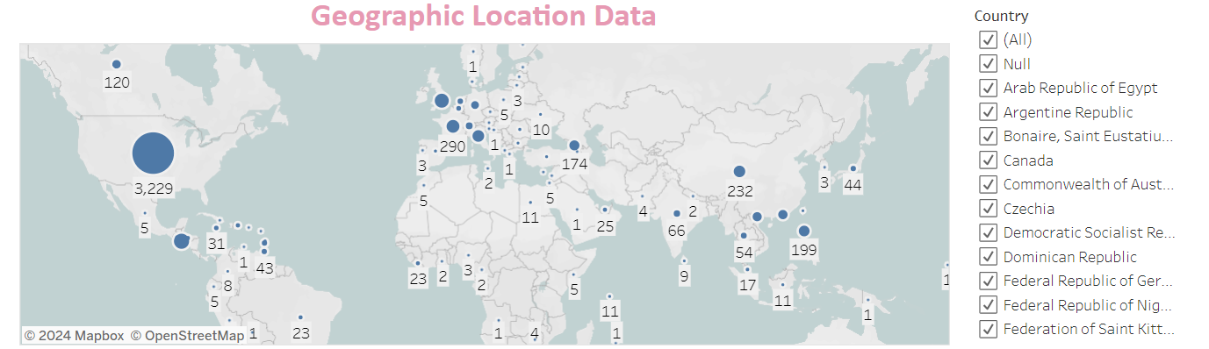
Tableau dashboards:
Notes:
Here are some more visualizations that we made using Tableau.
This visualization gives us the geographical distribution of the ads.

Slide 10
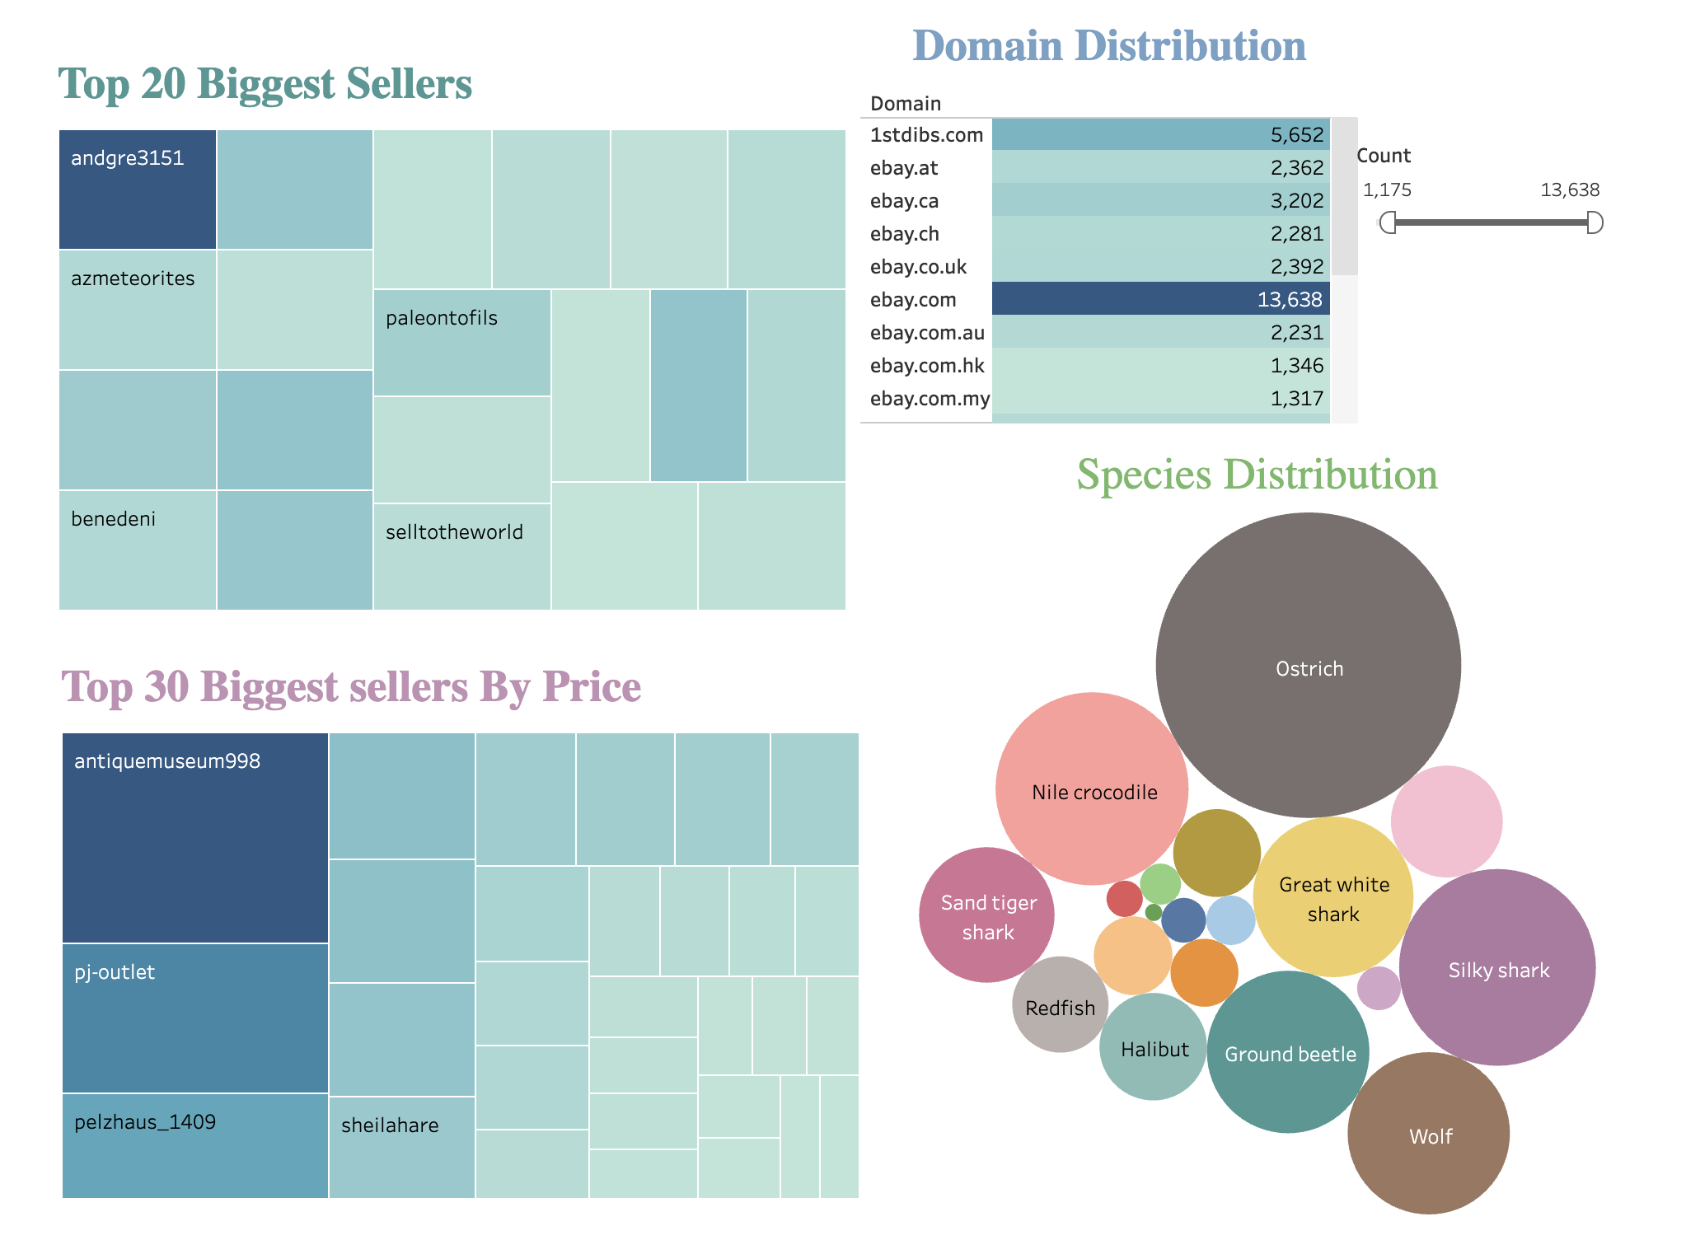
Tableau dashboards:
Notes:
Here we provide the visualization for Biggest sellers - one by their number of listings and the other by the total price of their listings.

Slide 11
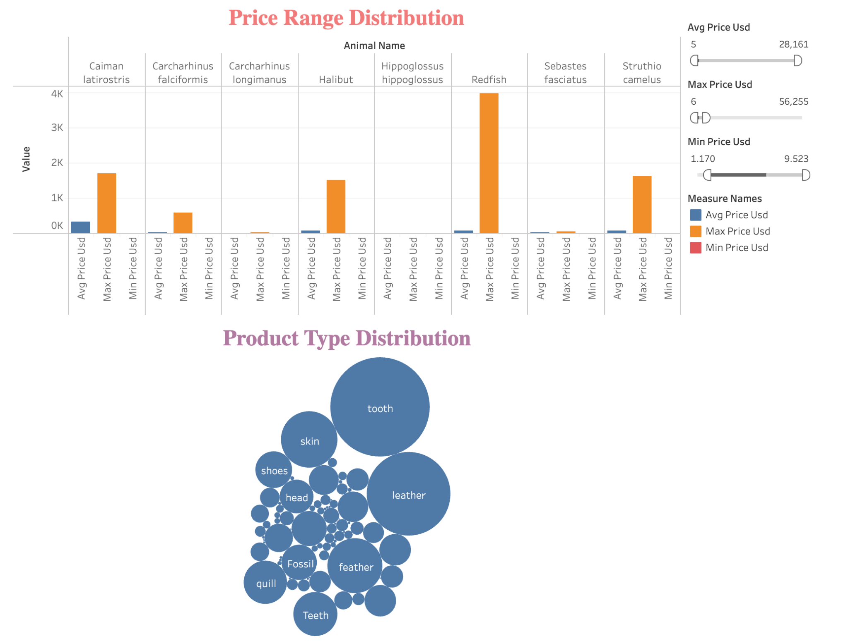
Tableau dashboards:
Notes:
Another graph to provide us some insights about the price distribution of each animal and the product type distribution in the ads.

Slide 12


Notes:
Thats our insights on the wildlife data. Thank you.

